Slide 1

Damage Detection & Classification
of Fruits Using Image Processing Technique
Supervised by
Sadia Jahan
Lecturer
Department of CSE, City University
Presented by
SL. NO. | NAME | ID | BATCH | DEPT.
01 | Md. Emran Hasan | 152392002 | 39th | CSE
02 | Saiful Islam Sajon | 152392317 | 39th | CSE

Slide 2
Presentation Outline
Abstract
Machine Learning
Research Challenges
Proposed Method
Dataset Description
Experimental Analysis
Experimental Result
Future Works
Conclusion
References

Slide 3
Abstract
The food processing industry has been working with different kind of fruits. Most of the industries who are classifying the classes and the damages of fruit by manual. As a result of manual classification, it will become a challenging task for the human. So, in this research work, we have proposed a method with a machine learning technique that classify various kinds of fruits automatically. Also, we will detect damage on fruit using image processing technique like Graph-cut or HSV color segmentation technique.

Slide 4

Machine learning
Logistic Regression (LR)
Linear Discriminant Analysis (LDA)
K-nearest neighbor (KNN)
Decision Tree Classifier (CART)
Random Forest Classifier (RF)
Gaussian Naive Bayes (NB)
Support Vector Machine (SVM)
Picture courtesy: https://pngio.com
Notes:
Classification And Regression Tree (CART)

Slide 5
Related Works
In 2018 Mureşan et al.[1] introduce a method for fruit recognition from images.
Contribution:
The Convolutional Neural Networks (CNN) gives better accuracy in different scenario.
Achieved accuracy between 91.91% - 95.41%
They introduced a high quality of dataset that includes different kind of fruits.
TensorFlow is used in order to implement the method.
Limitation:
This is a more time consuming process

Slide 6
Related Works(cont.)
In 2015 Bhange et al.[2] proposed a web based tool for pomegranate disease detection.
Contribution:
Image processing technique is used for disease detection.
k-means algorithm used for clustering and SVM for training and classification.
82% accuracy of identifying pomegranate disease.
Limitation:
Worked with a small dataset.
Worked with only one fruit.

Slide 7
Related Works(cont.)
In 2015 Awate et al.[3] proposed an efficient smart farming technique which will help for better yield and growth with less human efforts.
Contribution:
Artificial Neural Network (ANN) concept is used for pattern matching and classification of diseases.
OpenCV library is applied for implementation.
K-means clustering method is applied for image segmentation.
Achieved 90% accurate result.
Limitation:
Find the disease of fruit but not the damage.
Worked with only three fruits.

Slide 8

Research Challenges
Selecting Training and Testing dataset.
Extracting features
Marge extracted features
Train models
Picture courtesy: http://www.topsocialscoop.com
Notes:
Classification And Regression Tree (CART)

Slide 9
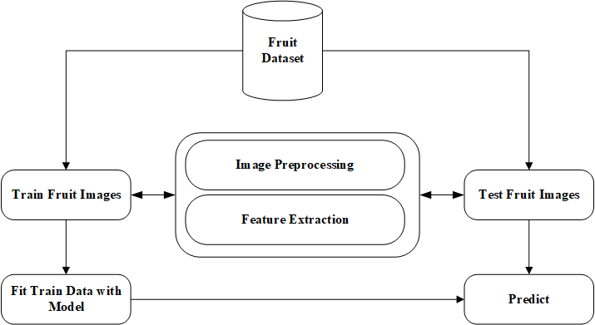
Proposed Method
Split the dataset into two part training and testing
Image Preprocessing
Extract feature
Fit Training data to the ML model
Logistic Regression (LR)
Linear Discriminant Analysis (LDA)
K-nearest neighbor (KNN)
Decision Tree Classifier (CART)
Random Forest Classifier (RF)
Gaussian Naive Bayes (NB)
Support Vector Machine (SVM)
Predict The Result
Figure 1: Proposed method for fruit identification.

Slide 10
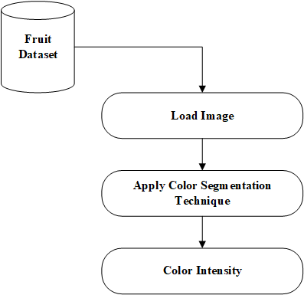
Proposed Method(Con.)
Load Damage Image From Dataset
Segment Color Of the Damage Image
Graph-cut
HSV color space
Represent color intensity using histogram plot.
Figure 2: Proposed Method for Fruit Damage Detection.

Slide 11
Dataset Description
No. | Data set | No. of Features | Types of features | Working Instances | Training Instances | Testing Instances | Classes | Category
01 | Fruits-360 | 3 | Color, Shape, Texture | 8685 | 7185 | 1500 | 15 | Semi Supervised
Table 01: Fruit Dataset

Slide 12
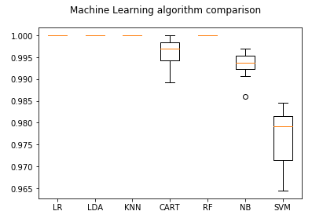
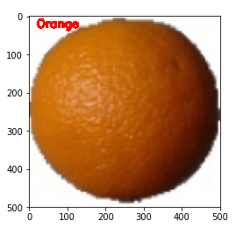
Experimental Analysis
Machine Learning Algorithm Comparison
Figure 3: Predicted Result
Figure 4: Accuracy

Slide 13
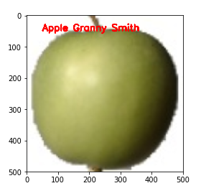
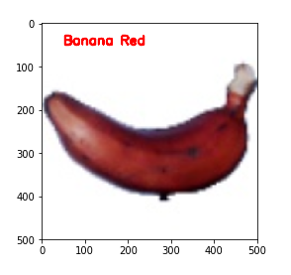
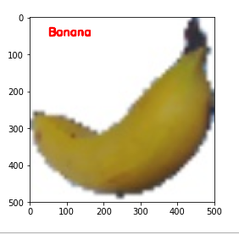
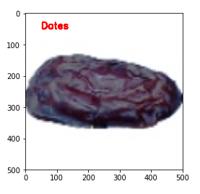
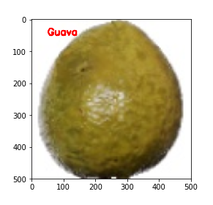
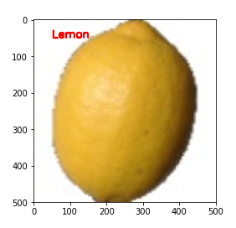
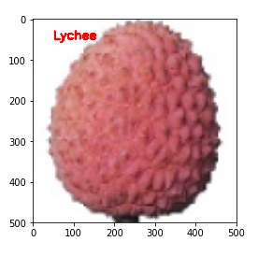
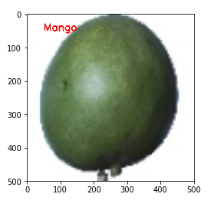
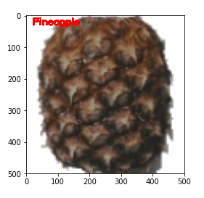
Experimental Result
Figure 5: Fruit Identification Results

Slide 14
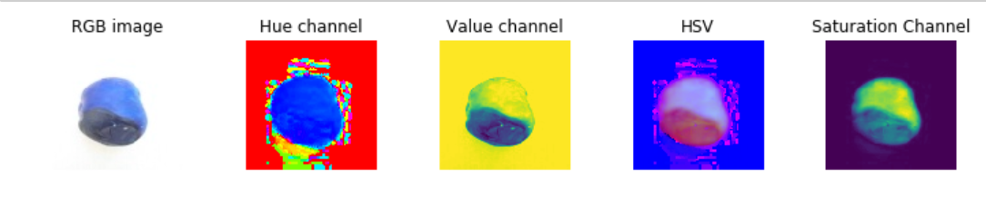
Experimental Result (Con.)
Figure 6: HSV Representation

Slide 15
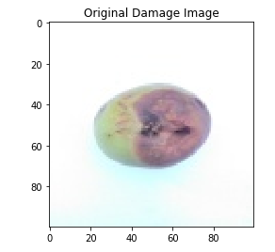
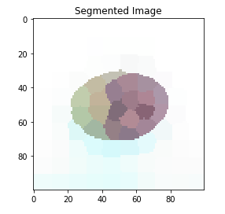
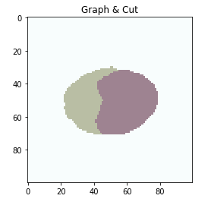
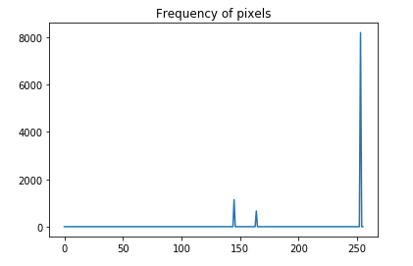
Experimental Result (Con.)
Figure 7: Graph-Cut Color Segmentation

Slide 16
Conclusion & Future Scope
Machine learning technique is very effective to classify fruits.
In this research work we already completed one part is identify the fruit.
We achieved best accuracy.
Damage detection on fruit image with better accuracy.
Percentage of damages will be measured.

Slide 17
References
[1] Mureşan, Horea, and Mihai Oltean. "Fruit recognition from images using deep learning." Acta Universitatis Sapientiae, Informatica 10, no. 1 (2018): 26-42.
[2] Md. Imran Hosen, Tahsina Tabassum, Jesmin Akhter, Md. Imdadul Islam, “Detection of Fruits Defects Using Colour Segmentation Technique”, International Journal of Computer Science and Information Security (IJCSIS), Vol. 16, No. 6, June 2018.
[3] PL.Chithra , M.Henila, “Fruits Classification Using Image Processing Techniques”, International Journal of Computer Sciences and Engineering, Vol. 7(5), Mar 2019, E-ISSN: 2347-2693

Slide 18
References
[4] Saeideh Gorji Kandi, “Automatic Defect Detection and Grading of Single-Color Fruits Using HSV (Hue, Saturation, Value) Color Space”, Dec. 2010, Volume 4, No.7 (Serial No.32) Journal of Life Sciences, ISSN 1934-7391, USA.
[5] Mr.S V.Phakade, Miss. D’souza Flora, Miss. Halade Malashree, Miss. Joshi Rashmi, “Automatic Fruit Defect Detection Using HSV and RGB Color Space Model”, International Journal of Innovative Research in Computer Science & Technology (IJIRCST), ISSN: 2347- 5552, Volume-2, Issue-3, May-2014.
[6] Bhange, Manisha, and H. A. Hingoliwala. "Smart farming: Pomegranate disease detection using image processing." Procedia Computer Science 58 (2015): 280-288.

Slide 19
References
[7] Mohana S.H., Prabhakar C.J., and Praveen Kumar P.U , “Surface Defect Detection and Grading of Apples”, DOI: 03.AETS.2013.4.33, Association of Computer Electronics and Electrical Engineers, 2013
[8] Awate, Ashwini, Damini Deshmankar, Gayatri Amrutkar, Utkarsha Bagul, and Samadhan Sonavane. "Fruit disease detection using color, texture analysis and ANN." In 2015 International Conference on Green Computing and Internet of Things (ICGCIoT), pp. 970- 975. IEEE, 2015.
[9] Zalak R. Barot, Narendrasinh Limbad, “An Approach for Detection and Classification of Fruit Disease: A Survey”, International Journal of Science and Research (IJSR), ISSN (Online): 2319-7064.

Slide 20
Thank you , everyone!

